Slide 1



lundi 1 février
Dans ma ville
Obj: Overall revision on my town.

Slide 2
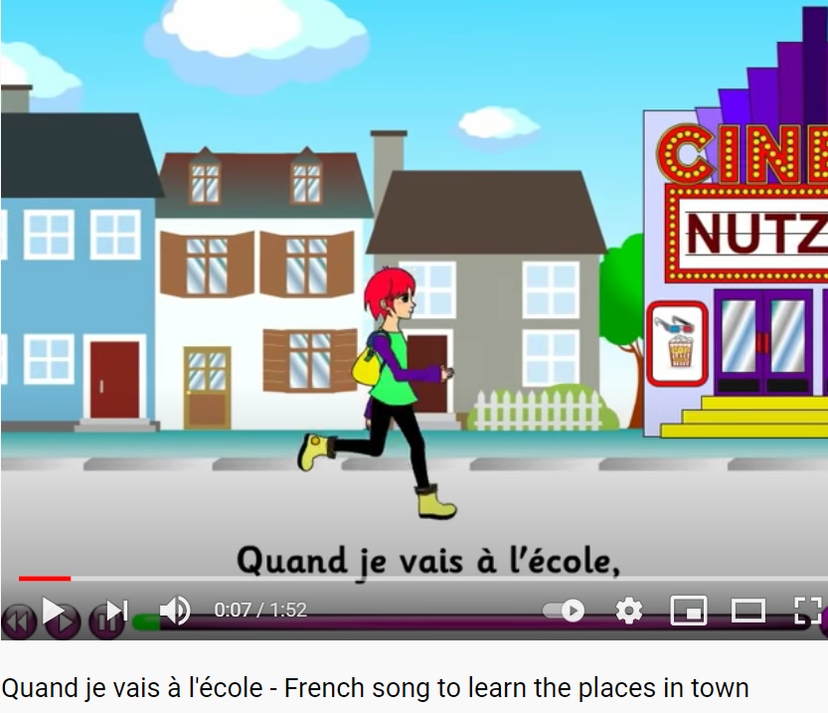
Regardons une vidéo
Click on the link below.
Quand je vais a l’école
On your whiteboard, note down at least 5 places in the video.

Slide 3
Réponses vidéo
Click on the link below.
Quand je vais a l’école
Une école
2.Un cinéma
3. Une église
4. Un café
5. Un musée
6. Un parc
7. La poste
8. Une gare
9. Un zoo
10. Une rivière

Slide 4



Slide 5
Règlement du Jeu
Notes:
Trainers Note: Split the group into two teams
Explain:
As you may of noticed this training session is based upon ‘Who wants to be a Millionaire’
If the ’contestant’ that is giving the answers gets an incorrect answer they will hear this sound (click mouse on this icon ) and their team will pass the questions over to the opposing team.
As the ‘contestant answers the questions the points earnt will be shown across the indicator at the top of the screen and as in the TV show as you hit certain levels you can bank the points earnt. These ‘banking’ points are…(click mouse for next slide)

Slide 6

BONNE CHANCE !
Notes:
Trainers Note;
Ensure all contestants have a piece of paper and pen ready for the first question.
Explain:
The first question asks you to put the four answers into order as quickly as possible. The first person to write down the correct answer ( e.g. D A B C ) and hold up the piece in the air wins the opportunity for their team to go first!

Slide 7




What is the French for ‘Where do you live’?
A
J’habite à
B
Comment t’appelles-tu?
C
Quelle est la
date de ton anniversaire?
D
Notes:
Ask Question and give 4 possible answers

Slide 8
What is the French word for ‘where do you live’?
D
Où habites-tu?

Slide 9
What is the French for
‘it’s in the north-west…’ ?
A
C’est dans le sud-est.
B
C’est dans le nord- ouest.
C
C’est dans le sud –oust.
D
C’est dans le nord- est.
Notes:
Ask Question and give 4 possible answers

Slide 10
What is the French for
‘it’s in the north-west…’ ?
B
C’est dans le nord- ouest.
Notes:
Explain:
That the Sales Manager Information booklets sent to them last week is titled ‘The Route to Success’ and takes the delegate through planing motivation and coaching

Slide 11
Translate: Dans ma ville, je préfère mon école.
A
In my village I love my school.
B
In my town I like my school.
C
D
In my village I prefer my
School.
In my town I prefer my school.
Notes:
Ask Question and give 4 possible answers

Slide 12
Translate: Dans ma ville, je préfère mon école.
C
In my town I prefer my school.
Notes:
Explain:
That all plans should be:
S PECIFIC
M EASURABLE
A CHIEVABLE
R EALISTIC
T IMELY

Slide 13
Translate:
Où habites-tu?
A
What is there in your town?
B
Where do you live?
C
How are you?
D
How old are you?
Notes:
Ask Question and give 4 possible answers

Slide 14
Translate:
Où habites-tu?
B
Where do you live?
Notes:
Ask Question and give 4 possible answers
Explain;
Having our own Account Card is very important to Debenhams. It helps us in three key ways:
Increased Sales
The Debenhams Account Card:
Offers 10% off purchases within the first week of opening a Debenhams Account, which means customers will select more items to take advantage of the discount
Increases spend by giving customers more spending power
Helps overcome price objections and allows customers to make larger purchases more often.
Gives customers the chance to spread their payments.
Customer Loyalty
Statement offers, mailings and sale previews encourage our customers to return to the store and repeat spend
Talking about the card the with customers is a good way of building customer relationships.
Building a relationship with our customers through the Account card is offering good customer service.
Increased Profits
When our customers shop with their Debenhams Card, this increases Debenhams profits.
The Average Transaction value on the Debenhams account card is £35 compared to only £22 on all other tender types.

Slide 15
Find the correct translation for:
I love, and I don’t like
C
J’adore,
je n’aime pas
Notes:
Ask Question and give 4 possible answers
Explain;
To be eligible to open an Account the customer must be:
18 or over
in permanent paid employment (applicant or spouse) for
more than 16 hours per week or self employed or retired or
be in receipt of invalidity/disability allowance
resident in the UK for the last 12 months (or have a BFPO address)

Slide 16
Find the correct translation for:
I love, and I don’t like
C
J’adore,
je n’aime pas
Notes:
Ask Question and give 4 possible answers
Explain;
To be eligible to open an Account the customer must be:
18 or over
in permanent paid employment (applicant or spouse) for
more than 16 hours per week or self employed or retired or
be in receipt of invalidity/disability allowance
resident in the UK for the last 12 months (or have a BFPO address)

Slide 17
Find the only feminine word.
Une église
B
A
Le café
C
Un hôtel
D
L’hôpital
Notes:
Ask Question and give 4 possible answers

Slide 18
Find the only feminine word.
Une église
A
Notes:
As per the Sales Impact document

Slide 19
Which word does not refer to the topic of my town ?
A
sud
B
village
C
anniversaire
D
magasins
Notes:
Ask Question and give 4 possible answers

Slide 20
Which word does not refer to the topic of my town ?
C
anniversaire
Notes:
Ask Question and give 4 possible answers

Slide 21
Find the negative sentence:
A
J’adore le marché
B
Il n’y a pas de marché.
C
Il y a un excellent marché.
D
J’aime le marché.

Slide 22
Find the negative sentence:
B
Il n’y a pas de marché.
Notes:
Ask Question and give 4 possible answers
Explain:
Purchase Protection
Covers selected purchases on the Account Card for up to 60 days
against loss, theft or accidental damage. There is a £20 excess
per claim.

Slide 23
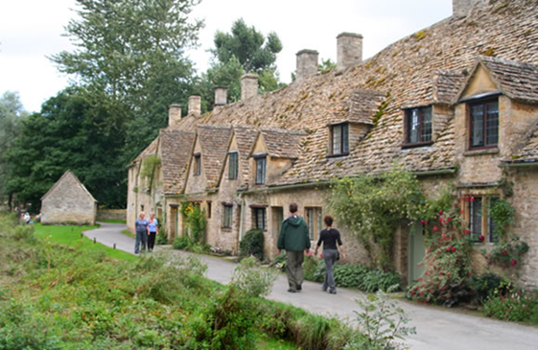
Noughts and crosses – Le morpion
60
I live
44
J’habite dans le
Sud-est de
l’Angleterre.
C’est grand et
intéressant.
20
15

Slide 24
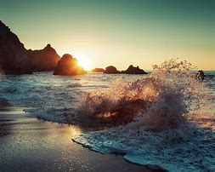
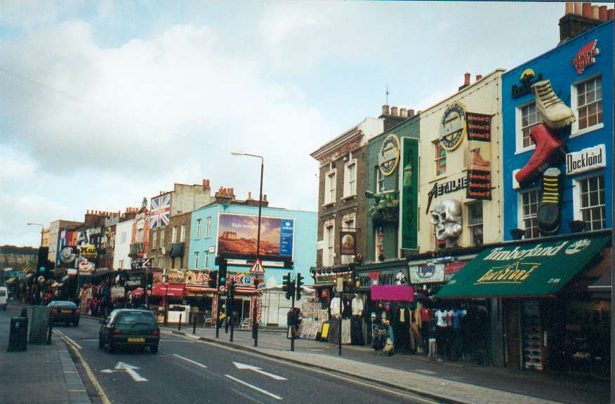

Noughts and crosses – Le morpion
J’adore
mon petit
village.
Il n’y a pas
de musée
25
Je préfère
Le cinema moderne.
14
12

Slide 25
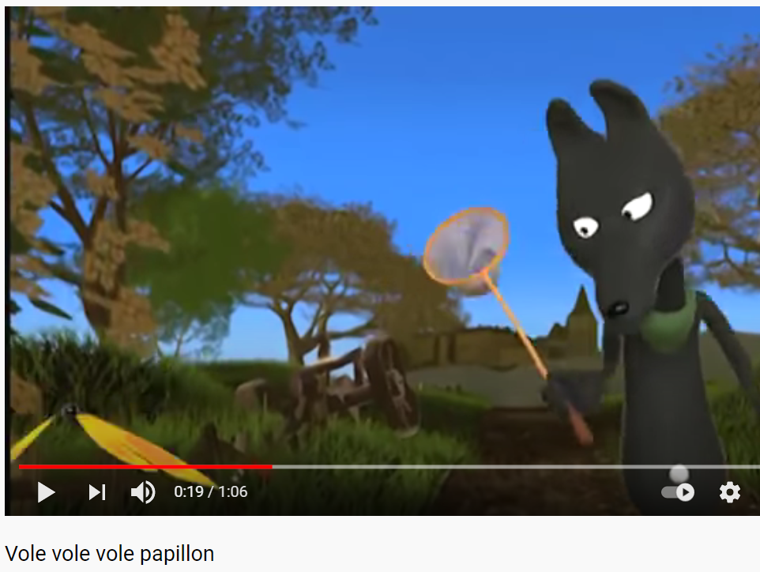

Nous avons fini. Au revoir.
Clique ici:
Vole, vole Papillon

