Slide 1
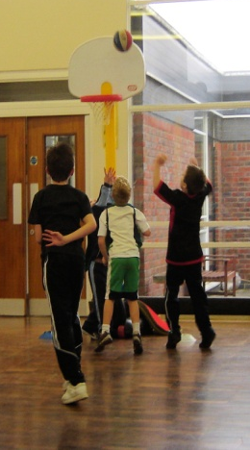
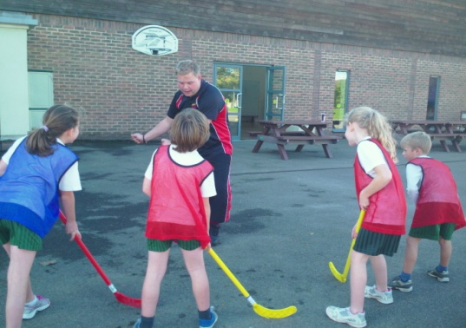
CHILDRENS PARTIES
PPA COVER
HOLIDAY CLUBS
www.risingstars-online.co.uk
01273 579606
sussex@risingstars-online.co.uk
Bolney Primary School Multi-Sports Club
Friday Afternoon 3.15pm – 4.15pm
Key Stage 2
Come and learn some new sports skills with Rising Stars!
Sessions will include football, basketball, tag rugby, cricket, short tennis and more!
The emphasis on our courses is FUN!
To book a place, please return the reply section of this form together with a non-refundable cheque or cash for £20.00 to the SCHOOL OFFICE.
Cheques should be made payable to
Rising Stars Multi-Sports Ltd.
Places will be allocated on a first come first served basis with a minimum of 8 and a maximum of 20 children allowed to attend. Your child's place is only guaranteed if the School office receives the completed consent form below
Booking form– Example School Adventure Course- All Years. Autumn First Half 2012.
I ______________________ consent for my child ______________________ to participate in the Rising Stars Gymnastics Course. Emergency telephone number: __________________________________ Does you child have any medical conditions?____________________________________________________ My child is/is not being picked up (please circle). RISING STARS are not under any liability whatsoever in respect of loss or damage of clothing however caused whilst attending this course. Signed Parent/Guardian _______________________
All children should wear suitable clothing for sports.
www.risingstars-online.co.uk 01462 790152 multi-sports@risingstars-online.co.uk
Club Dates: 28th April, 5th,12th,19th,26th May
Bolney Primary School Multi-Skills Club. Friday Afternoon Summer Term 2017
I _________________________________ consent for my child __________________________________
to participate in the Rising Stars Multi-Skills Course.
Emergency telephone number: __________________________________________________________ Childs D.O.B:_____/______/____ E – mail: _______________________________________________ Does your child have any medical conditions? _____________________________________________ RISING STARS are not under any liability whatsoever in respect of loss or damage of clothing however caused whilst attending this course. Signed Parent/Guardian __________________________________________________________________
Booking form– Example School Adventure Course- All Years. Autumn First Half 2012.
I ______________________ consent for my child ______________________ to participate in the Rising Stars Gymnastics Course. Emergency telephone number: __________________________________ Does you child have any medical conditions?____________________________________________________ My child is/is not being picked up (please circle). RISING STARS are not under any liability whatsoever in respect of loss or damage of clothing however caused whilst attending this course. Signed Parent/Guardian _______________________
www.risingstars-online.co.uk 01462 790152 multi-sports@risingstars-online.co.uk

Slide 2
CHILDRENS PARTIES
PPA COVER
HOLIDAY CLUBS
www.risingstars-online.co.uk
01273 579606
sussex@risingstars-online.co.uk
Bolney Primary School Multi-Sports Club
Friday Afternoon 3.15pm – 4.15pm
Key Stage 2
Come and learn some new sports skills with Rising Stars!
Sessions will include football, basketball, tag rugby, cricket, short tennis and more!
The emphasis on our courses is FUN!
To book a place, please return the reply section of this form together with a non-refundable cheque or cash for £20.00 to the SCHOOL OFFICE.
Cheques should be made payable to
Rising Stars Multi-Sports Ltd.
Places will be allocated on a first come first served basis with a minimum of 8 and a maximum of 20 children allowed to attend. Your child's place is only guaranteed if the School office receives the completed consent form below
Booking form– Example School Adventure Course- All Years. Autumn First Half 2012.
I ______________________ consent for my child ______________________ to participate in the Rising Stars Gymnastics Course. Emergency telephone number: __________________________________ Does you child have any medical conditions?____________________________________________________ My child is/is not being picked up (please circle). RISING STARS are not under any liability whatsoever in respect of loss or damage of clothing however caused whilst attending this course. Signed Parent/Guardian _______________________
All children should wear suitable clothing for sports.
www.risingstars-online.co.uk 01462 790152 multi-sports@risingstars-online.co.uk
Club Dates: 28th April, 5th,12th,19th,26th May
Bolney Primary School Multi-Skills Club. Friday Afternoon Summer Term 2017
I _________________________________ consent for my child __________________________________
to participate in the Rising Stars Multi-Skills Course.
Emergency telephone number: __________________________________________________________ Childs D.O.B:_____/______/____ E – mail: _______________________________________________ Does your child have any medical conditions? _____________________________________________ RISING STARS are not under any liability whatsoever in respect of loss or damage of clothing however caused whilst attending this course. Signed Parent/Guardian __________________________________________________________________
Booking form– Example School Adventure Course- All Years. Autumn First Half 2012.
I ______________________ consent for my child ______________________ to participate in the Rising Stars Gymnastics Course. Emergency telephone number: __________________________________ Does you child have any medical conditions?____________________________________________________ My child is/is not being picked up (please circle). RISING STARS are not under any liability whatsoever in respect of loss or damage of clothing however caused whilst attending this course. Signed Parent/Guardian _______________________
www.risingstars-online.co.uk 01462 790152 multi-sports@risingstars-online.co.uk

